Slide 1


Santosh Kumar Kar,
skkar.2k2@gmail.com

Slide 2
CHAPTER – 1
Micro Services Introduction
Santosh Kumar Kar,
skkar.2k2@gmail.com

Slide 3
What is Web Service
It is a client-server application or application component for communication.
The method of communication between two devices over the network.
It is a software system for the interoperable machine to machine communication.
It is a collection of standards or protocols for exchanging information between two devices or application.

Slide 4
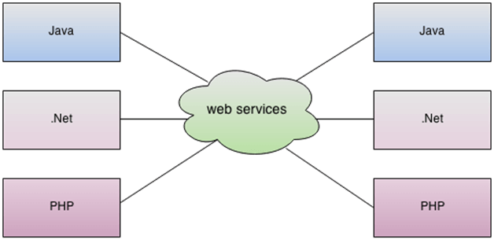
What is Web Service

Slide 5
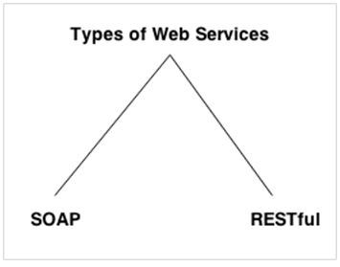
Types of Web Services

Slide 6
SOAP Services
Advantages
WS Security: SOAP defines its own security known as WS Security.
Language and Platform independent: SOAP web services can be written in any programming language and executed in any platform.
Disadvantages
Slow: SOAP uses XML format that must be parsed to be read. It defines many standards that must be followed while developing the SOAP applications. So it is slow and consumes more bandwidth and resource.
WSDL dependent: SOAP uses WSDL and doesn't have any other mechanism to discover the service.

Slide 7
Rest Services
Fast: RESTful Web Services are fast because there is no strict specification like SOAP. It consumes less bandwidth and resource.
Language and Platform independent: RESTful web services can be written in any programming language and executed in any platform.
Can use SOAP: RESTful web services can use SOAP web services as the implementation.
Permits different data format: RESTful web service permits different data format such as Plain Text, HTML, XML and JSON.

Slide 8
SOAP vs REST
No. | SOAP | REST
1) | SOAP is a protocol. | REST is an architectural style.
2) | SOAP stands for Simple Object Access Protocol. | REST stands for REpresentational State Transfer.
3) | SOAP can't use REST because it is a protocol. | REST can use SOAP web services because it is a concept and can use any protocol like HTTP, SOAP.
4) | SOAP uses services interfaces to expose the business logic. | REST uses URI to expose business logic.
5) | JAX-WS is the java API for SOAP web services. | JAX-RS is the java API for RESTful web services.
6) | SOAP defines standards to be strictly followed. | REST does not define too much standards like SOAP.
7) | SOAP requires more bandwidth and resource than REST. | REST requires less bandwidth and resource than SOAP.
8) | SOAP defines its own security. | RESTful web services inherits security measures from the underlying transport.
9) | SOAP permits XML data format only. | REST permits different data format such as Plain text, HTML, XML, JSON etc.
10) | SOAP is less preferred than REST. | REST more preferred than SOAP.

Slide 9
Software Architecture Patterns
Layered Architecture (aka n-tier architecture pattern)
Event-Driven Architecture.
Microkernel Architecture.
Microservices Architecture Pattern.
Space-Based Architecture.

Slide 10


Micro Service

Slide 11
What is Microservice
Highly maintainable and testable
Loosely coupled
Independently deployable
Organized around business capabilities
Owned by a small team

Slide 12
Key principles
Autonomy-
each service operates and changes independently of others
Resilience
application or infrastructure failure may only affect part of your system
Transparency
Each application generate separate log metrics
Automation
Alignment

Slide 13
The Twelve Factors
https://12factor.net/

Slide 14

Difference between Monolithic Application & Microservice Application

Slide 15
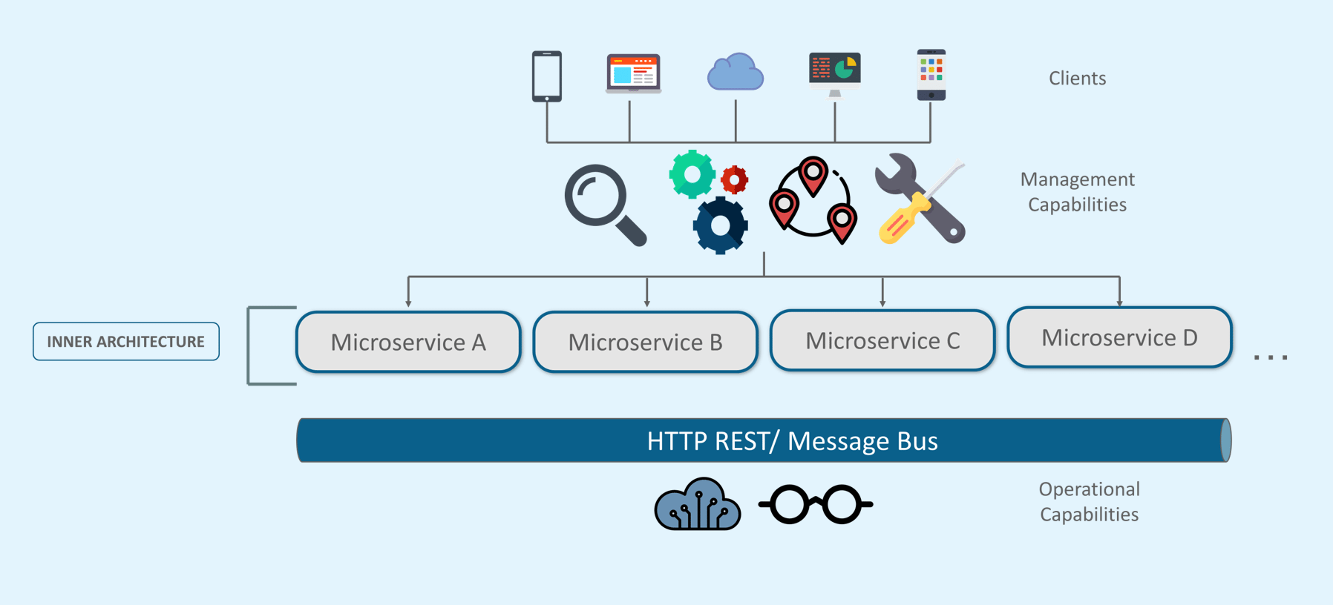
Microservice Architecture

Slide 16
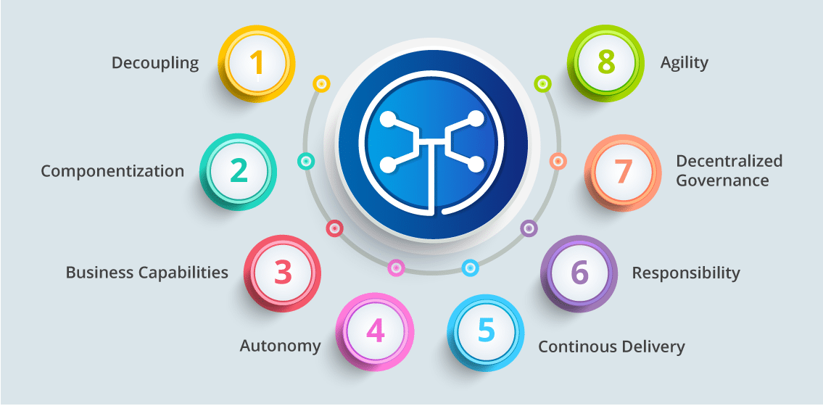
Microservice Features

Slide 17

Companies use Microservice

Slide 18
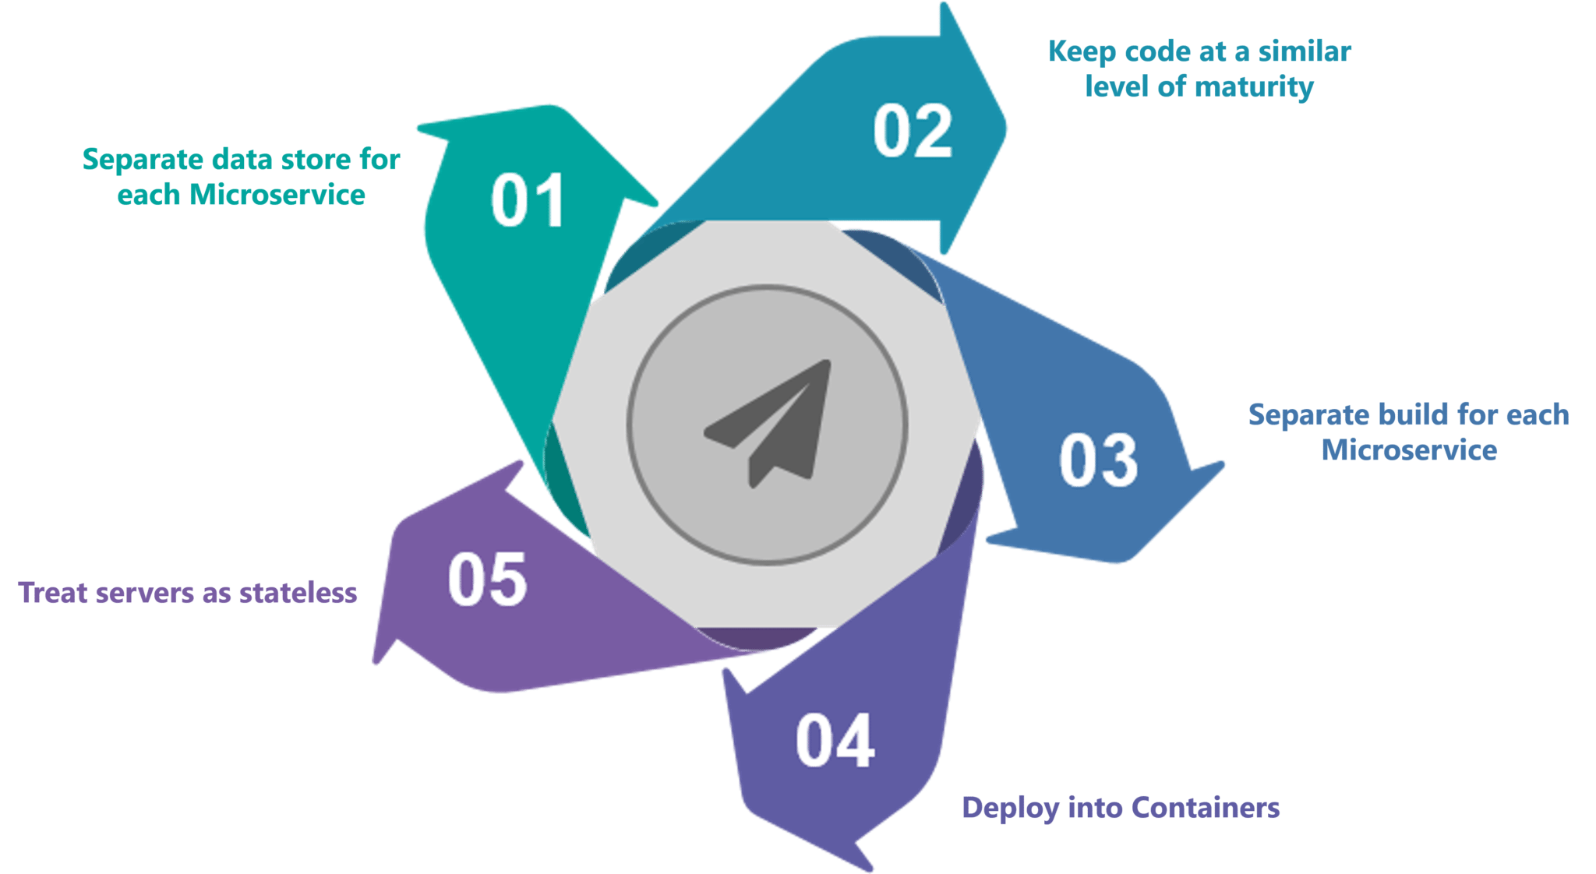
Best Practice to design Microservice

Slide 19
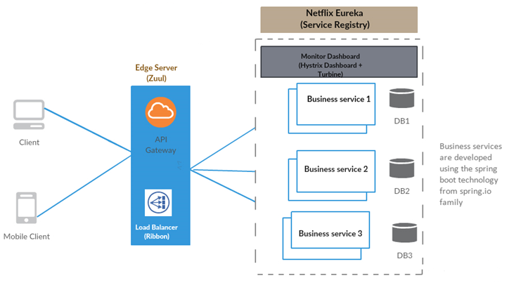

Slide 20

Questions
Send to skkar.2k2@gmail.com

